Slide 1
Fantasy Basketball Draft Kit
By Robert Cheer

Slide 2
What is Fantasy Basketball?
Fantasy basketball is a game where you draft real NBA players and aggregate their statistics. Each week, you compare your teams aggregated stats to your opponent and each category you win you get a win and each category you lose you get a loss.

Slide 3
Creating a Ranking System
Rankings used each of the top 200 players by season. Each player was ranked on each category by the amount of standard deviations above the mean. Here were the top 5 players in 2017, you may be surprised that there is no Lebron James or Russell Westbrook on the list.
1) Anthony Davis 2) Steph Curry 3) James Harden 4) Kevin Durant 5) Karl Towns

Slide 4
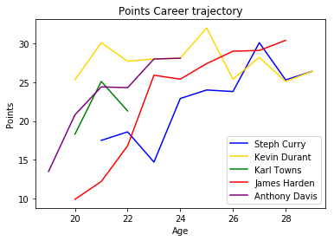
Feature Importance: What Impacts Performance?
If a players team has no personnel changes, you can relatively accurately predict next season by just looking at the career trajectory and age of a player.
In the 90s and 2000s, big name players didn’t change teams very much, so you could come up with a relatively accurate prediction for next year just using last seasons stats, but now big players are changing teams frequently

Slide 5
Important Features: Ball Dominant Teammates
In basketball, there are only 5 players on a court and one ball, so one player can impact the others on the court dramatically. My model used different advanced statistics * minutes depending on category to factor in whether or not one of your teammates is dominating the ball.
A prime example of that is the rise of Russell Westbrook following the departure of Kevin Durant
Anthony Davis finished first among the fantasy basketball ranks last season following the injury to Demarcus Cousins

Slide 6
Error Testing: Cross Validation and Model Selection
Tests were run using data starting from the 2008-09 season up until the 2016-17 season (may add more data). Cross validated using k-fold cross validation with a RMSE cost function and ran grid searches on gradient boosting while also testing Linear Regression and Rectified Linear Unit Neural Networks.
Error Rates were tested against a baseline of choosing last seasons average.
Linear Regression and Gradient Boosting models were selected based on the lowest error on the test sets.
Best models for each category were run on 2017-18 data.

Slide 7
Results: Comparing to Yahoo Rankings
After selecting the final model, loaded in Yahoos preseason rankings from 2017-18 season.
Created rankings based on my predicted model
Compared my rankings as well as yahoos rankings to the actual rankings using Rank Bias Overlap. My model outperformed all Yahoo Experts at each level of the top n sample players.

Slide 8
Predicting Next Season
With the departure of Demarcus Cousins, Anthony Davis is projected to retain his number 1 spot.
Gordon Hayward is expected to fall the most coming off an injury and joining a stacked Celtics team with young guys that could challenge him for playing time
Meanwhile, Buddy Hield and Pascal Siakam who both gained starting spots on teams without ball dominant players are expected to rise the most.

Slide 9
Next Steps
1) Get more data for rookies and Olympic team players. These are two points of variance that my data doesn’t explain.
2) I would like to create a class where you could compare your team to other teams and see what categories you can potentially win, which could help more advanced players
3) Trade Evaluator, look at potential trades, whether or not they are fair and how they could potentially benefit both sides.
4) Injury prediction, my model was thrown off when major players were hurt impacting their performance and that of their teammates.

Slide 10
Thank You!

